Slide 1

CSE 3521: Introduction to Artificial Intelligence
[These slides are partially adapted from the UC Berkeley. CS188 Intro to AI at UC Berkeley]

Slide 2
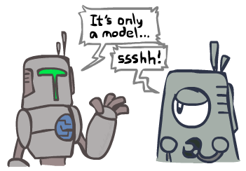
Search and Models
Search operates over models of the world
The agent doesn’t actually try all the plans out in the real world!
Planning is all “in simulation”
Your search is only as good as your models…

Slide 3
Uninformed vs. Informed Search
Uninformed search
Given no information about problem (other than its definition)
Find solutions to problems by systematically generating new states and testing for goal
Informed search
Given some ideas of where to look for solutions
Use problem-specific knowledge

Slide 4
Example: Pancake Problem
Cost: Number of pancakes flipped

Slide 5
Example: Pancake Problem
State space graph with costs as weights
S
4
2
3
2
3
4
G
3
4
2
3
2
2
4
3
Notes:
A* expanded 8100 ; Path cost = 33
UCS expanded 25263 . Path cost = 33
Greedy expanded 10 . Path cost = 41
[0, 7, 5, 3, 2, 1, 4, 6]
(7, 0, 5, 3, 2, 1, 4, 6)
(6, 4, 1, 2, 3, 5, 0, 7)
(3, 2, 1, 4, 6, 5, 0, 7)
(1, 2, 3, 4, 6, 5, 0, 7)
(5, 6, 4, 3, 2, 1, 0, 7)
(6, 5, 4, 3, 2, 1, 0, 7)
(0, 1, 2, 3, 4, 5, 6, 7)

Slide 6
General Tree Search
Action: flip top two Cost: 2
Action: flip all four Cost: 4
Path to reach goal:
Flip four, flip three
Total cost: 7
Notes:
You know exactly where you came from and how you got there, but you have no idea where you’re going. But, you’ll know it when you see it.

Slide 7
Search Heuristics
A heuristic is
A function that estimates how close a state is to a goal
Designed for a particular search problem
Examples: Manhattan distance, Euclidean distance for pathing
not the exact “path” distance

Slide 8
Example: Heuristic Function
Heuristic: the number of the largest pancake that is still out of place
3
h(x)
4
3
4
3
0
4
4
3
4
4
2
3

Slide 9
Example: Heuristic Function
h(x)

Slide 10

Greedy Search
Expand the node that seems closest…
What can go wrong?
Does not guarantee the optimal solution

Slide 11
Greedy Search
b
Strategy: expand a node that you think is closest to a goal state
Heuristic: estimate of distance to nearest goal for each state
A common case:
Best-first takes you straight to the (wrong) goal
Worst-case: like a badly-guided DFS
…
b
…
Notes:
For any search problem, you know the goal. Now, you have an idea of how far away you are from the goal.

Slide 12
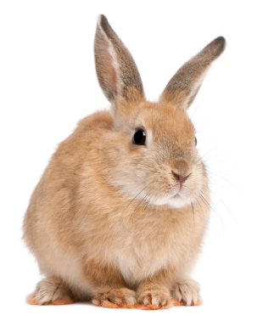
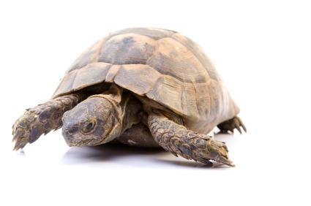
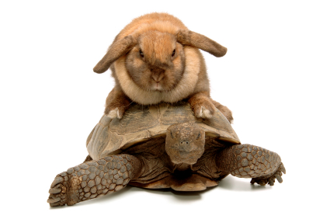
A* Search
UCS
Greedy
A*

Slide 13
Combining UCS and Greedy
Uniform-cost orders by path cost, or backward cost g(n)
Greedy orders by goal proximity, or forward cost h(n)
A* Search orders by the sum: f(n) = g(n) + h(n)
8
g = 0 h=6
S
e
h=1
g = 1 h=5
a
1
1
3
2
g = 2 h=6
g = 9 h=1
S
a
d
G
b
d
g = 4 h=2
e
h=6
1
h=5
h=2
h=0
1
g = 3 h=7
g = 6 h=0
g = 10 h=2
c
b
c
G
d
h=7
h=6
g = 12 h=0
G

Slide 14
When Should we terminate A*
Should we stop when we enqueue a goal?
No: only stop when we dequeue a goal
A
2
2
S
h = 3
h = 0
G
2
B
3
h = 1

Slide 15
Is A* Optimal?
h = 6
1
A
3
S
h = 7
G
h = 0
5
What went wrong?
Actual bad goal cost < estimated good goal cost
We need estimates to be less than actual costs!

Slide 16
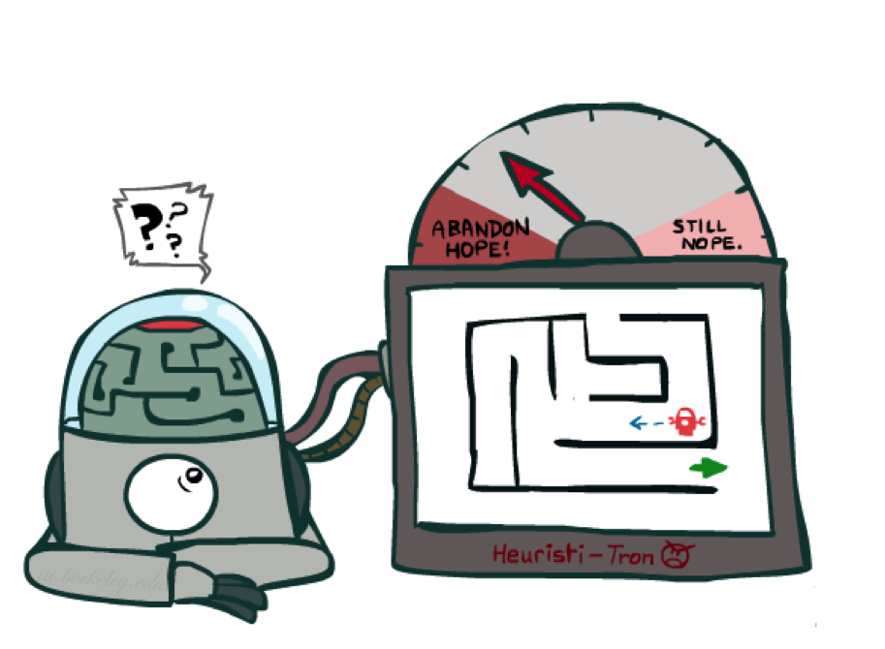
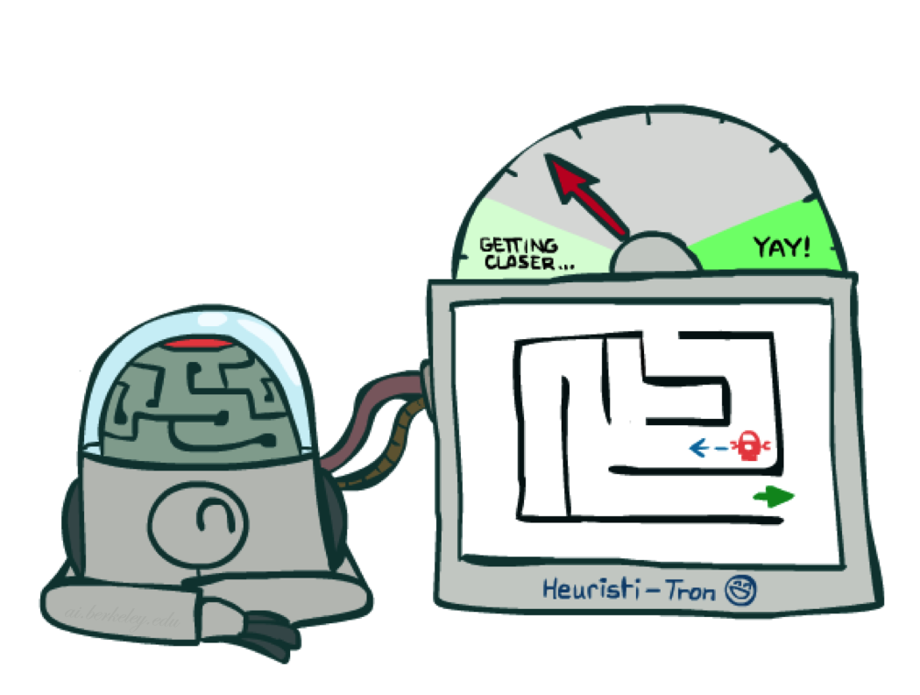
Idea: Admissibility
Inadmissible (pessimistic) heuristics break optimality by trapping good plans on the fringe
Admissible (optimistic) heuristics slow down bad plans but never outweigh true costs

Slide 17

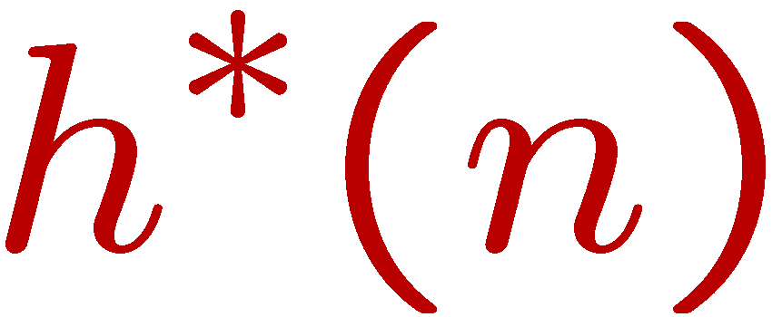
Admissible Heuristics
A heuristic h is admissible (optimistic) if:
where is the true cost to a nearest goal
Coming up with admissible heuristics is most of what’s involved in using A* in practice.

Slide 18
UCS vs. A* Contours
Uniform-cost expands equally in all “directions”
A* expands mainly toward the goal, but does hedge its bets to ensure optimality
Start
Goal
Start
Goal

Slide 19
A* Applications
Video games
Pathing / routing problems
Resource planning problems
Robot motion planning
Language analysis
Machine translation
Speech recognition
…

Slide 20
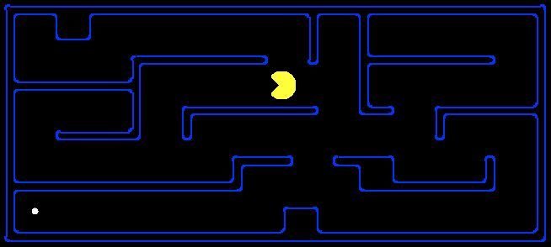
Creating Admissible Heuristics
Most of the work in solving hard search problems optimally is in coming up with admissible heuristics
Often, admissible heuristics are solutions to relaxed problems, where new actions are available
366
15

